Slide 1

UVM RAL
UVM REGISTER ABSTRACTION LAYER

Slide 2
UVM RAL
Reusability – same RAL model can be used in another environments for the same design.
Once a RAL model integrated into the verification Environment , a verification engineer can access registers by using write(),read() methods.
We have front door access and back door access in uvm ral model.

Slide 3
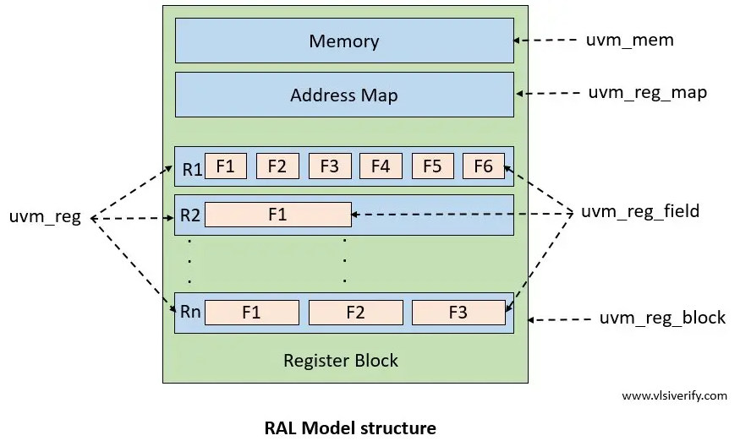
RAL MODEL STRUCTURE
T

Slide 4
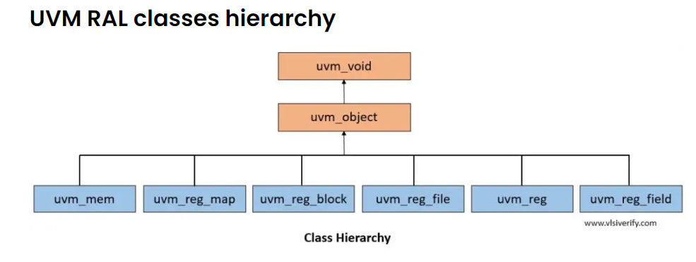
UVM RAL CLASS HIERARCHY

Slide 5
UVM_REG_BLOCK
The user-defined-register is derived from uvm_reg_block.
It consists of all registers, maps, register files and other register blocks.
A block can have one or more address maps, each corresponding to a physical interface on the block.
The Rigister block at the hierarchical level provides the "Register model" as instance.

Slide 6
METHODS | DESCRIPTION
new() | Create new instance
configure() | Configuration for specific instance
create_map() | Create the address maps in the blocks
set_default_map() | Defines the default address map
lock_model() | Lock the model and build the address map
get_block() | Get the sub blocks
Get_map() | Get the address map
METHODS | DESCRIPTION
Get_registers() | Get the registers
Get_fields() | Get the fields
Get_memories() | Get the memories
Reset() | Reset the mirror for the block
Update() | Update the mirrored values
Set_backdoor() | Set the user defined back door for all the registers in the block
Add_hdl_path | Add the hdl path.

Slide 7
Uvm_reg
The user defined register class is derived from uvm_reg.
It mimics the register of the design.
To represents fields in the register , RAL provides the uvm_reg_field class.

Slide 8
METHODS | DESCRIPTION
new() | Create new instance
cofiguration() | Configuration foe specific instance
set_offset() | Modifies the register off set
get_offset() | Return the Register off set
get_address() | Returns the base external physical address of the registers.
get_fields() | Returns the register fields
set() | Set the desired value of the register
 | METHODS | DESCRIPTION
 | get() | Get the desired value of the register
 | update() | Update the desired value of the register present in the DUT
 | read() | Read the current value from the register
 | write() | Write the specified value in the register
 | mirror() | Update the mirrored value for the register
 | set_backdoor() | Set the user defined backdoor for all the registers in the block
 | add_hdl_path() | Add the hdl path

Slide 9
UVM_REG_FIELD
It represents the fields of the register.
Each register can have one or more fields that can has different policies out of which RW,RO,W1C,W1S etc.

Slide 10
Uvm_reg_access_policies
ACCESS_POLICIES | DESCRIPTION
RO | Read only. It can simply read from the register field value. Writing a field has no effect.
RW | Read write. Fixed value can be read or write.
W1C | Write 1 to clear. 1)Writing 1 clears the corresponding bit. 2)writing 0 has no effect. 3)Reads the field value.
W1S | Write 1 to set. 1)Writing 1 to set the corresponding bit. 2)Writing 0 has no effect. 3)Reads the field value.

Slide 11
METHODS | DESCRIPTION
new() | Create a new instance.
configure() | Configuration for specific instance.
set_access() | Set the access policy of the field.
get_access() | Get the access policy of the field.
set() | Set the desired value of the field.
get() | Get the desired value of the field.
reset() | Reset the desirred/mirrored value of the field.
METHODS | DESCRIPTION
read() | Read the current value from the field.
write() | Write the specified value in the field.
mirror() | Update the mirrored value for the field.

Slide 12
UVM_REG_FILE
METHODS | DESCRIPTION
new() | Create a new instance.
configure() | Configuration for a specific instance.
get_reg_file() | Get the parent register file.
add_hdl_path() | Add the hdl path.
The uvm_reg file is derived from uvm_reg_file. the register file is nothing but a set of registers or register files.
These are the methods in the uvm_reg_files.

Slide 13
UVM_MEM
UVM_RAL supports memory implementation
As uvm_reg mimics registers of DUT similarly, uvm_mem mimics the memory of DUT.
The following are the uvm_mem methods.

Slide 14
Uvm_mem methods
METHODS | DESCRIPTION
new() | Create a new instance.
configure() | Configuration for a specific instance.
set_offset() | Modifies the memory offset.
get_offset() | Returns the memory offset.
get_address() | Returns the base address of the memory location.
read() | Read the current value from the memory location.
write() | Write the specified value in the memory location.
set_backdoor | Set the user defined back door for the memory.
get_backdoor | Get the user defined back door for the memory.
add_hdlpath | Add the HDL path.

Slide 15
UVM_REG_MAP
The user defined uvm reg map is abase class used to access the model via specific interface/bus.
The following are the uvm reg map methods.

Slide 16
Uvm_reg_map_methods
METHODS | DESCRIPTION
new() | Create a new instance.
configure() | Configuration for a specific instance.
add_reg() | Add a register.
add_mem() | Add a memory.
add_submap | Add an address map.
reset() | Reset the mirror for all the registers in this address map.
set_sequencer() | Set the sequencer and the associated adapter for the map.
get_sequencer() | Get the sequencer and associated adapter for the map.
get_registers() | Get the registers.
get_reg_by_offset | Get register mapped at offset.
get_mem_by_offset | Get memory mapped at offset.

Slide 17
RAL ADAPTER
The uvm register model methods like the write() and read() deals with the register transactions.
DUT accepts or sends signal level transactions from/to the testbench by an interface.
Hence there is a requirement to convert register transactions to bus transactions and vice versa.
This is full filled by the "Register Adapter", the user defined adapter class is derived from the uvm_reg_adapter base class.

Slide 18
Ral_Adapter_methods
Every front door access operation read() or write() method calls passes through reg2bus and bus2reg API. A user must implement these two methods.
Reg2bus :- It converts register transactions to bus transactions.
Bus2reg :- It converts bus transactions to reg transactions.

Slide 19
RAL PREDICTOR
The UVM RAL predictor is a component that updates mirror values based on transactions on a physical interface for which UVM provides the "uvm_reg_predictor" base calss.
In front door access, UVM RAL provides three models for the predictor as
Implicit(auto)Prediction.
Explicit Prediction.
Passive Prediction.

Slide 20
Auto Prediction
Auto
In auto prediction, front door access methods automatically call a predict() method for any transaction happening over a bus i.e. reading data from a register or writing data to the register at the end of the clock cycle.
Auto
To enable auto prediction : call set_auto_predict() method. The RAL model fails to update if method returns UVM_NOT_OK status.
Advantage
Advantage :- Simple Implementation.
Disadvantage
Disadvantage :- It can't update the register model if register sequences are written to access DUT registers.

Slide 21
Explicit Prediction
It is the default mode of prediction that involves an explicit external predictor component that snoop for bus transactions and calls the predict() method to update its mirrored register value.
Since it directly interacts with bus transactions, it requires a register adapter to convert bus transactions into a register transaction.
To enable explicit prediction : It is enabled by default.
Advantage :- This mode keeps the register model updated for transaction over the target bus interface.
Disadvantage :- Extra predictor component has to instance, configure and connect.

Slide 22
Passive Prediction
The passive prediction is similar to an explicit prediction that uses a predictor component except the front door register access methods can't be used.
Advantage :- This mode keeps the register model updated for transaction over the target bus interface.
Disadvantage :- front door register access methods can't be used. Only backdoor access is possible. Hence it is rarely used.

Slide 23
WRITE( )
Write() method writes the value of the DUT register.
It also updates desired and mirrored value.

Slide 24
READ( )
Read() method reads the value of the DUT register and updates desired and mirrored value.

Slide 25
SET( )
Set( ) method updates desired value and does not write the register of the DUT.
To update the desired value to the DUT register.
The update( ) method can be used.

Slide 26
GET( )
Get() method reads the desired value and does not read the actual register in the DUT.

Slide 27
UPDATE( )
Update() method updates desired value to the register in the DUT if there is a difference between desired and mirrored value.

Slide 28
MIRROR( )
Mirror( ) method behaves the same as the read() method, additionally it compares the value with mirrored value if check argument = UVM_CHECK.
An error is reported if the mirrored value differs from the read value of the DUT.

Slide 29
PEEK( )
The peek( ) method is used to read the actual value of a register from the DUT using a back door access.
The peek( ) method allows you to retrieve the current value of a register directly from DUT.

Slide 30
POKE( )
The poke( ) method is used to write a value to a register in the DUT using a back door access.
The poke( ) method allows you to modify the value of a register directly in the DUT.
It operates on the register model's desired value, not the actual value in the DUT.

Slide 31

THANK YOU

